Slide 1


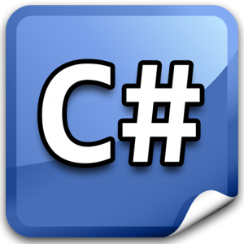


C# Tips and Tricks
20 C# 5.0 Tips and Tricks
C# Tips and Tricks
Telerik Academy Plus
http://academy.telerik.com

Slide 2

Table of Contents
Syntactic Sugar and Language Features in C#
Traps
Useful .NET Classes and Methods
Debugging Tips
Unit Testing
Demos: github.com/NikolayIT/CSharp-Tips-and-Tricks

Slide 3

Syntactic Sugar and Language Features in C#

Slide 4
Casting vs the 'as' Operator
When casting from one type to another fails the CLR will throw an exception
Use it when failing to cast means bug
When using the 'as' operator, in case of fail no exception will be thrown but the value will be null
When using 'as' always consider the null value
The 'is' operator can check the type of a variable
object number = "Five";
// This will cause InvalidCastException
var numberAsInt = (int?)number;
// The next line will be evaluated without exception
var numberAsInt = number as int?;
// Here numberAsInt will be null because the cast is invalid

Slide 5
Combinable Enum Values
Enums can be used to store a combination of different values (called bit-flags)
Standard enums can only support one value
[Flags] allow us to have combination of values
[Flags]
public enum Margins
{
None = 0, Top = 1, Left = 2, Bottom = 4, Right = 8,
}
var bottomRight = Margins.Bottom | Margins.Right; // 8+4=12
bottomRightMargin == Margins.Bottom // False
bottomRightMargin.HasFlag(Margins.Bottom); // Тrue

Slide 6
Optional Parameters
Optional parameters enable us to omit arguments for some parameters
The default value has to be a constant, parameterless constructor of a value type or default(T) for some type T
When using them we should note that the default value is embedded in the caller's assembly
If we change the default value without rebuilding the calling code, we'll still see the old value
BankAccount(string accountHolder, decimal money = 1000) { … }
// We can use both BankAccount("X") and BankAccount("X", 100)

Slide 7
Using yield
yield allows each iteration in a foreach-loop be generated only when needed
We use it in methods that return the type IEnumerable or IEnumerable<T>
Methods with yield can be foreached
C# compiler generates IEnumerator methods
IEnumerable<int> EvenNumbers(int from, int to) {
for (int i = from; i <= to; i++)
if (i % 2 == 0) yield return i;
}
foreach (var n in EvenNumbers(51, 60)) Console.WriteLine(n);

Slide 8
Constraining Generics
When define a generic class, we can apply restrictions to the kinds of type arguments
The type argument must be or derive from the specified base class or interface
The type argument must be a reference type (class) or a value type (struct)
The type argument must have a public parameterless constructor
class TemplateClass<T> where T : SomeClass
class TemplateClass<T> where T : class // where T : struct
class TemplateClass<T> where T : new()

Slide 9

Traps

Slide 10
Equality in .NET
There are two different kinds of equality
Value equality
The generally understood meaning of equality
Two objects contain the same values
For example, two integers with the value of 1337 have value equality
Reference equality
Also known as identity
Two object references refer to the same object
object a = new object();
object b = a;

Slide 11
Check References in .NET
To check for reference equality, use ReferenceEquals (returns Boolean)
To check for value equality, you should generally use Equals
Equals as it is implemented by Object just performs a reference check (we should override it)
By default, the operator == tests for reference equality (override it for immutable types)
object.ReferenceEquals(firstObject, secondObject)
firstObject.Equals(secondObject) // true or false
firstObject == secondObject // true or false

Slide 12
String References
String is a reference and immutable type
The CLR uses a method of storing only one copy of each distinct string value (string interning)
When apply += operator a new pointer to new data is created and returned
Use StringBuilder for string manipulations
var string1 = "some value";
var string2 = "some value";
// ReferenceEquals(string1, string2) is true
var stringFromConsole = Console.ReadLine(); // "some value"
// ReferenceEquals(string1, stringFromConsole) is false
var stringIntern = string.Intern(stringFromConsole);
// ReferenceEquals(string1, stringIntern) is true

Slide 13
Random Numbers in .NET
The Random class in .NET is a pseudo-random number generator (deterministic)
Any instance of Random has a certain amount of state (their seed value initially), also:
RNGCryptoServiceProvider generates high-quality random numbers
csharpindepth.com/Articles/Chapter12/Random.aspx
// These two instances will have the exact same seed
var firstRandomNumbersGenerator = new Random();
var secondRandomNumbersGenerator = new Random();

Slide 14
LINQ Multiple Enumeration
Consider the following code snippet
We are doing extra work by enumerating the collection twice in the two foreach statements
If GetDataObjects() results in a DB query we are executing the query twice with the same result
Can be fixed by forcing the enumeration with call to .ToList() method after GetDataObjects()
IEnumerable<DataObject> dataObjects = GetDataObjects();
foreach (var dataObject in dataObjects)
Console.WriteLine(dataObject);
var allObjectsAsString = new StringBuilder();
foreach (var dataObject in dataObjects)
allObjectsAsString.Append(dataObject + " ");

Slide 15
Preserving Stack Trace when Re-throwing Exceptions
These two same blocks simply re-throw the current exception keeping the stack trace:
The next block is different:
It will change the source and the stack trace
It will appear that the exception has been thrown from the current method from that very line
Prefer creating new custom exceptions
try { … } catch () { throw; }
try { … } catch (Exception e) { throw; }
try { … } catch (Exception e) { throw e; }

Slide 16
Exceptions & Static Constructors
A static constructor is called automatically to initialize the class before:
the first instance is created
or any static members are referenced
Once a type initializer has failed once, it is never retried (for the lifetime of the AppDomain)
Type will remain uninitialized
Creating instances will also fail
You should have a very good reason for throwing an exception from a static constructor

Slide 17

Useful .NET Classes and Methods

Slide 18
The Tuple Class
A Tuple is a generic data structure that has a specific number and sequence of elements
Each element can have any type (e.g. int, tuple)
Tuples are immutable (read-only)
Tends to provide low-quality code
Useful for private methods (params and return values) and composite keys in dictionaries
C# 7: www.infoq.com/news/2015/04/CSharp-7-Tuples
var dataObject = new Tuple<int, decimal>(4, 2.5);
Console.WriteLine("First value: {0}", dataObject.Item1);
Console.WriteLine("Second value: {0}", dataObject.Item2);

Slide 19
Method Deprecation
The [Obsolete] attribute in .NET marks a method that is about to be removed in future versions (called deprecated method)
The attribute generates a compiler warning
We can also generate a compiler error
It is a good practice to specify the new routine that has to be used in the message
[Obsolete("CreateXml() method is deprecated. Use CreateXmlReader instead.", false)] // true for error
public void CreateXml ()
{
}

Slide 20
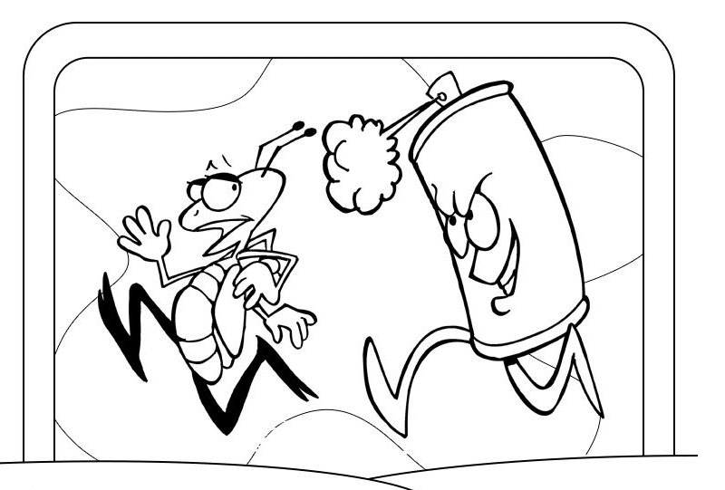
Debugging Tips

Slide 21
Debugger Variable Display
Control how debugger variables look like
When overridden ToString is used in the debugger variable windows for clsses
DebuggerDisplay controls how a class or field is displayed in the debugger variable windows
DebuggerBrowsable determines if and how a member is displayed in the debugger variable windows (values: Never, RootHidden)
[DebuggerDisplay("Student named {FirstName} {LastName}")]
[DebuggerBrowsable(DebuggerBrowsableState.RootHidden)]

Slide 22
Caller Info Attributes
Inject code properties during compile-time
CallerMemberName attribute will inject the name of the method/property that is calling the method
CallerFilePath attribute will inject the file path of the code file in which the caller is located
CallerLineNumber attribute will inject the line number in the code file in which the caller is located
GetCallerMemberName([CallerMemberName]string memberName = null)
GetCallerFilePath([CallerFilePath]string filePath = null)
GetCallerLineNumber([CallerLineNumber]int lineNumber = 0)

Slide 23
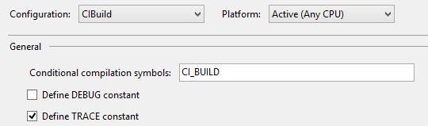
Preprocessor Symbols
Conditional compilation directives make it easy to build varying versions of an application simply by varying the preprocessor symbols
#if, #elif, #else and #endif control the conditional code execution
#if DEBUG
// Debug build
#elif CI_BUILD
// CI_BUILD is set
#else
#error Neither DEBUG nor CI_BUILD
#endif

Slide 24
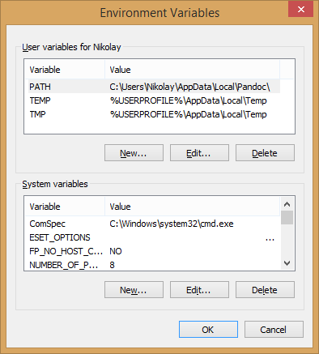
Current System Information
We can use the System.Environment class for gathering the current system information
// Get the current directory for the process
var currDir = Environment.CurrentDirectory;
// Get platform independent system directory path
Environment.GetFolderPath(Environment.SpecialFolder.Fonts)
// New line "\r\n" for non-Unix and "\n" for Unix plaforms
var currentPlatformNewLine = Environment.NewLine;
// Get logical drives (hard disk partitions)
var strArr = Environment.GetLogicalDrives();
// Get Current stack trace
var stackTrace = Environment.StackTrace;
// Get environment variables value
Environment.GetEnvironmentVariable("Path")

Slide 25

Unit Testing Tips

Slide 26
Test Internal/Private Members
Eas­i­est way out is to make the members pub­lic
Make the members pro­tected and have the unit test class extend this class to gain access
Use reflec­tion to invoke the members
Use Inter­nalsVis­i­bleTo for internal members
Use PrivateObject class for private members
[assembly: InternalsVisibleTo("ExposeInternals.Tests")]
var summator = new Summator();
var privateObject = new PrivateObject(summator);
var getZeroValue = privateObject.Invoke("GetZero");

Slide 27
C# Tips and Tricks
http://academy.telerik.com

Slide 28




Free Trainings @ Telerik Academy
C# Programming @ Telerik Academy
csharpfundamentals.telerik.com
Telerik Software Academy
academy.telerik.com
Telerik Academy @ Facebook
facebook.com/TelerikAcademy
Telerik Software Academy Forums
forums.academy.telerik.com

